Slide 1
Statistical Fallacies
A fallacy is reasoning that is logically invalid, or that undermines the logical validity of an argument. All forms of human communication can contain fallacies..
Fallacies are anomalies that considerably reduce the credibility of a report. Statistical fallacies are common in medical literature

Slide 2
Why does Fallacies Occur?
Some of the fallacies in medical literature may occur due to:
Problems with the sample: The investigation should provide sufficient and valid data to take a decision. Sometimes this does not happen for various reasons.
Inadequate analysis: Among the most common sources of fallacies in data-based conclusions is the use of inappropriate method of analysis.
Errors in presentation of findings: Out of ignorance or deliberate, the presentation of data in medical reports sometimes lack propriety. This can happen in a variety of ways.
Misinterpretation: Misinterpretation of statistical results is mostly due to failure to comprehend them in their totality and inability to juxtapose them with the realities of the situation. This can happen either because many medical professionals have limited knowledge of statistical concepts [8], or because of inadequate understanding of medical issues by the statisticians associated with medical projects.

Slide 3
Objectivity in interpretation
Objectivity means that we should be unbiased and remain un-influenced by our personal feelings, opinions or prejudices. Rather, our understanding or interpretation should be based on facts. In other words, the findings of the research are should be based on the data collected and not on the values, beliefs or opinions of the researcher
In order to be able to generalize their findings, quantitative researchers take great care to maintain objectivity and ensure that these findings are uncontaminated by any external influences including their own presence, their values, beliefs, biases and behaviours.

Slide 4
Maintaining Objectivity
Reiss and Sprenger (2014) provide strategies for maintaining objectivity in quantitative research which are explained below:
Focus on the facts and data collected: your interpretation should be based on the factual data that you have collected. You should be able to prove your hypothesis or your claims through the factual evidence that you have collected.
Ensure that the research is value free: as far as possible, your research should not reflect your own values alone. Our values influence the choice of the research design, the selection of the tools of measurement, the development of a hypothesis/research statement as well as the interpretation of the results. However, you can ensure that your values do not impinge on the design of the research and the interpretation of data by developing a stated value premise.

Slide 5
Developing objectivity in research
Myrdal provides guidelines on how this could be developed.
These include:
Relevance: – the value should be held by people or groups of people in society and should not be something that the researcher alone perceives as important
Significance: – a substantial number of people should view the value as being important; alternatively, a small but socially powerful group should consider the value as being one of great consequence.
Feasible:- values that aim for perfection or unattainable goals should not be considered as a base for research
Ensure that the research is free from personal biases
Ensure that the instrument we use for our research is reliable and valid.

Slide 6
Reliability
Reliability is concerned with consistency, accuracy and predictability of the scale. It refers to the extent to which a measurement process is free from random errors.
The reliability of a scale is measured using the following methods:
Test-retest reliability
Split half reliability method

Slide 7
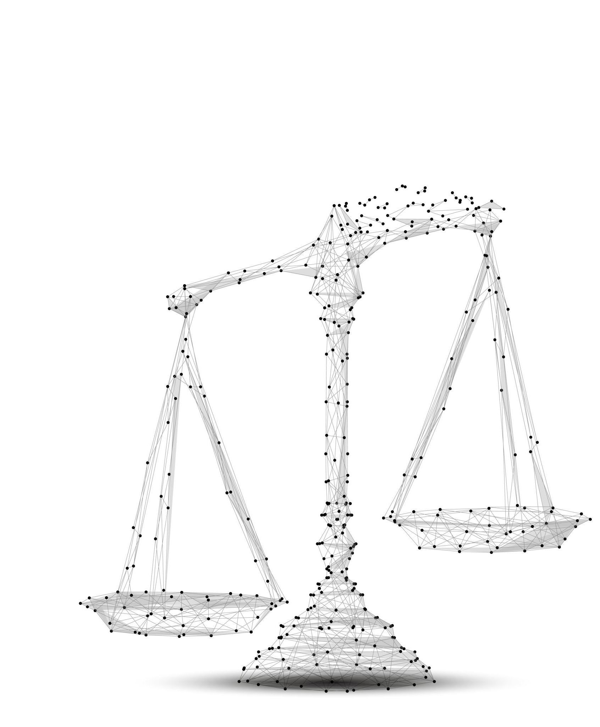
Validity
Validity of a scale refers to the question whether we are measuring what we want to measure.
Validity of the scale refers to the extent to which the measurement process is free from both the systematic and random error.
Types of validity measure:
Content Validity
Concurrent Validity
Predictive Validity

